Slide 1

Carbon Cars
Abdul Ahmed, Adam Filiz, Maverick Ho

Slide 2
What our app does
Track carbon footprint (CO2 emissions) over time
See total CO2 emissions
With weekly/monthly data visualizations
Steps of use:
Input personal vehicle information
Or select public bus option
Click ”Start ride” button on main menu
When done with ride, click “Stop ride”
Get data visualization and trip information!

Slide 3
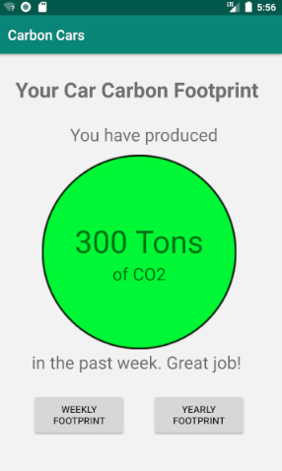
What we’ve done
Location tracking
Get the distance and speed every 9 seconds
Basic list trip viewing
See total car carbon footprint (how much CO2 you’ve emitted)
Weekly and yearly graphs of CO2 emissions over time

Slide 4
What’s left to do
Fix up UI –– kind of barebones at the moment
Add up distances traveled and convert that to CO2 emission data
Then use that information for displaying trips and total footprint
Add monthly bar chart
Line chart might be more fitting
Add vehicle information entering menu (with database to store vehicle information)
Add intro for new users

Slide 5
Thanks!
Any questions?
Temporary logo made by Eucalyp from www.flaticon.com

